Slide 1
N. Rizk
COSC 2430 : Data Structures
College of Natural and Applied Sciences
Department of Computer Science
University of Houston

Slide 2
Definition
An Abstract List (or List ADT) is linearly ordered data where the programmer explicitly defines the ordering
We will look at the most common operations that are usually
The most obvious implementation is to use either an array or linked list
These are, however, not always the most optimal

Slide 3

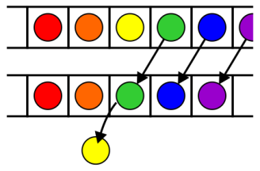
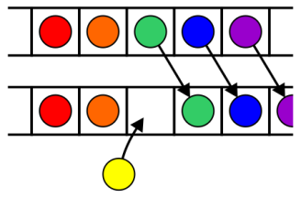
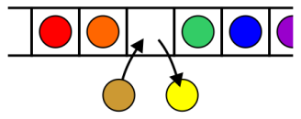
Operations
Operations at the k^{th} entry of the list include:
Access to the object Erasing an object
Insertion of a new object Replacement of the object

Slide 4
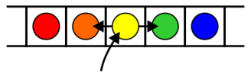
Operations
Given access to the k^{th} object, gain access to either the previous or next object
Given two abstract lists, we may want to
Concatenate the two lists
Determine if one is a sub-list of the other

Slide 5
Locations and run times
The most obvious data structures for implementing an abstract list are arrays and linked lists
We will review the run time operations on these structures
We will consider the amount of time required to perform actions such as finding, inserting new entries before or after, or erasing entries at
the first location (the front)
an arbitrary (k^{th}) location
the last location (the back or n^{th})
The run times will be Θ(1), O(n) or Θ(n)

Slide 6
Linked lists
We will consider these for
Singly linked lists
Doubly linked lists

Slide 7
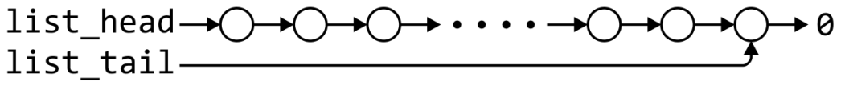
Singly linked list
 | Front/1st node | k^{th} node | Back/n^{th} node
Find | Θ(1) | Ο(n)* | Θ(1)
Insert Before | Θ(1) | Ο(n)* | Θ(n)
Insert After | Θ(1) | Θ(1)* | Θ(1)
Replace | Θ(1) | Θ(1)* | Θ(1)
Erase | Θ(1) | Ο(n)* | Θ(n)
Next | Θ(1) | Θ(1)* | n/a
Previous | n/a | Ο(n)* | Θ(n)
* These assume we have already accessed the k^{th} entry—an O(n) operation

Slide 8
Singly linked list
 | Front/1st node | k^{th} node | Back/n^{th} node
Find | Θ(1) | Ο(n)* | Θ(1)
Insert Before | Θ(1) | Θ(1)* | Θ(1)
Insert After | Θ(1) | Θ(1)* | Θ(1)
Replace | Θ(1) | Θ(1)* | Θ(1)
Erase | Θ(1) | Θ(1)* | Θ(n)
Next | Θ(1) | Θ(1)* | n/a
Previous | n/a | Ο(n)* | Θ(n)
By replacing the value in the node in question, we can speed things up
– useful for interviews

Slide 9
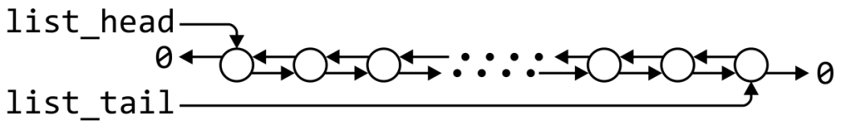
Doubly linked lists
 | Front/1st node | k^{th} node | Back/n^{th} node
Find | Θ(1) | Ο(n)* | Θ(1)
Insert Before | Θ(1) | Θ(1)* | Θ(1)
Insert After | Θ(1) | Θ(1)* | Θ(1)
Replace | Θ(1) | Θ(1)* | Θ(1)
Erase | Θ(1) | Θ(1)* | Θ(1)
Next | Θ(1) | Θ(1)* | n/a
Previous | n/a | Θ(1)* | Θ(1)
* These assume we have already accessed the k^{th} entry—an O(n) operation

Slide 10
Doubly linked lists
Accessing the k^{th} entry is O(n)
 | k^{th} node
Insert Before | Θ(1)
Insert After | Θ(1)
Replace | Θ(1)
Erase | Θ(1)
Next | Θ(1)
Previous | Θ(1)

Slide 11
Other operations on linked lists
Other operations on linked lists include:
Allocation and de-allocating the memory requires Θ(n) time
Concatenating two linked lists can be done in Θ(1)
This requires a tail pointer

Slide 12
Arrays
We will consider these operations for arrays, including:
Standard or one-ended arrays
Two-ended arrays

Slide 13

Standard arrays
We will consider these operations for arrays, including:
Standard or one-ended arrays
Two-ended arrays

Slide 14
Run times
 | Accessing the k^{th} entry | Insert or erase at the
 |  | Front | k^{th} entry | Back
Singly linked lists | O(n) | Θ(1) | Θ(1)* | Θ(1) or Θ(n)
Doubly linked lists |  |  |  | Θ(1)
Arrays | Θ(1) | Θ(n) | O(n) | Θ(1)
Two-ended arrays |  | Θ(1)
* Assume we have a pointer to this node

Slide 15
Data Structures
In general, we will only use these basic data structures if we can restrict ourselves to operations that execute in Θ(1) time, as the only alternative is O(n) or Θ(n)
Interview question: in a singly linked list, can you speed up the two O(n) operations of
Inserting before an arbitrary node?
Erasing any node that is not the last node?
If you can replace the contents of a node, the answer is “yes”
Replace the contents of the current node with the new entry and insert after the current node
Copy the contents of the next node into the current node and erase the next node

Slide 16
Memory usage versus run times
All of these data structures require Θ(n) memory
Using a two-ended array requires one more member variable, Θ(1), in order to significantly speed up certain operations
Using a doubly linked list, however, required Θ(n) additional memory to speed up other operations

Slide 17
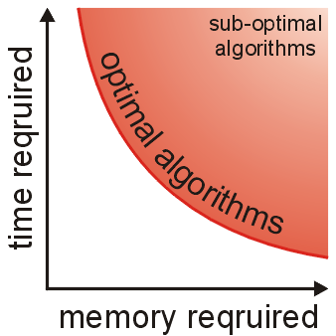
Memory usage versus run times
As well as determining run times, we are also interested in memory usage
In general, there is an interesting relationship between memory and time efficiency
For a data structure/algorithm:
Improving the run time usually requires more memory
Reducing the required memory usually requires more run time

